Slide 1
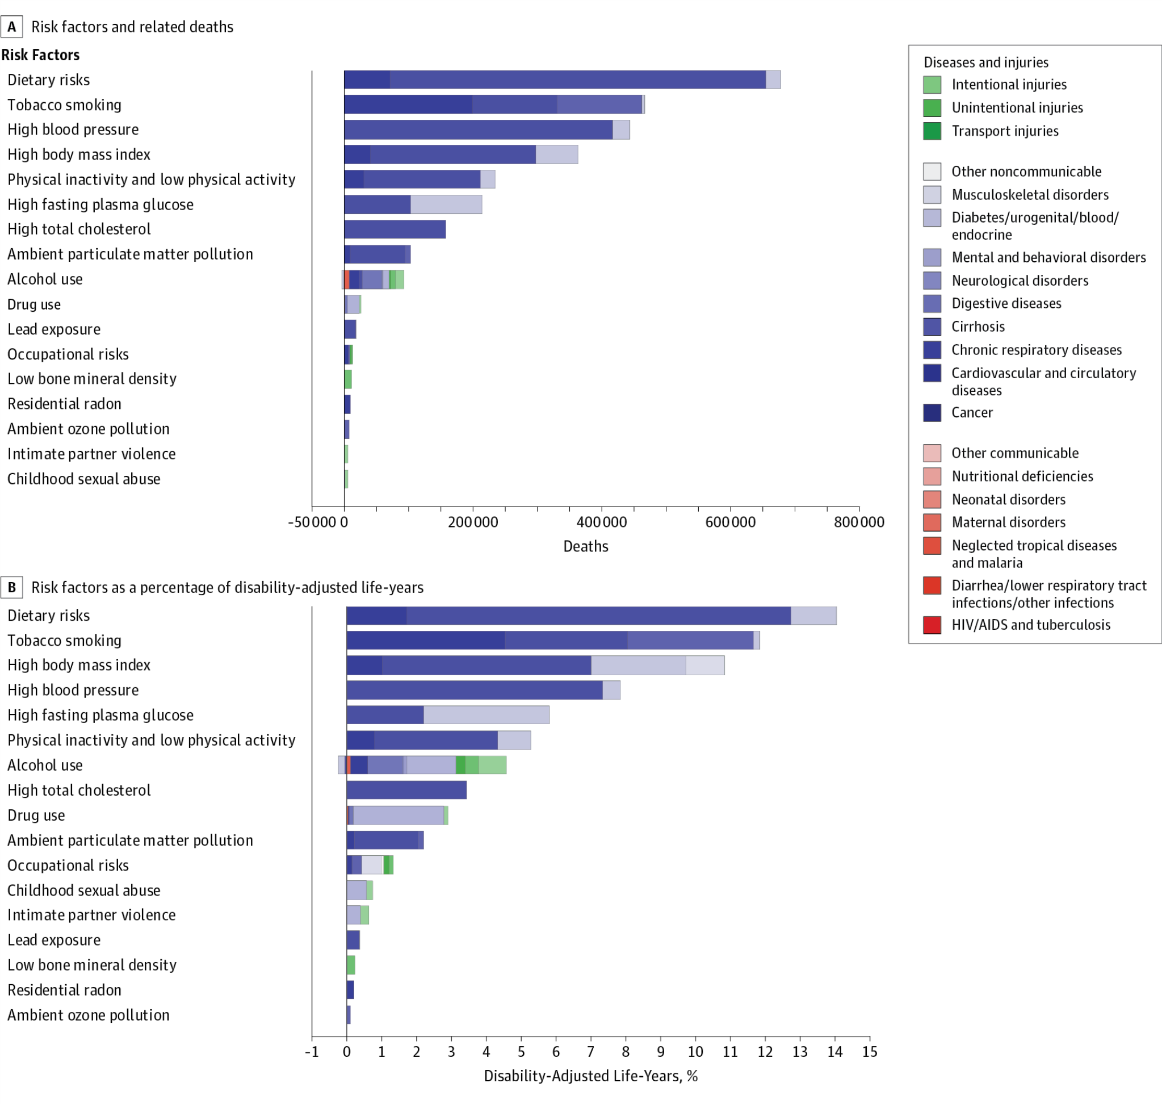
Spending on Prevention
4.2% on Primary Prevention
0.9% on screening
0.5% on research
3.0% other services
8.6 % of total national health spending

