Slide 1
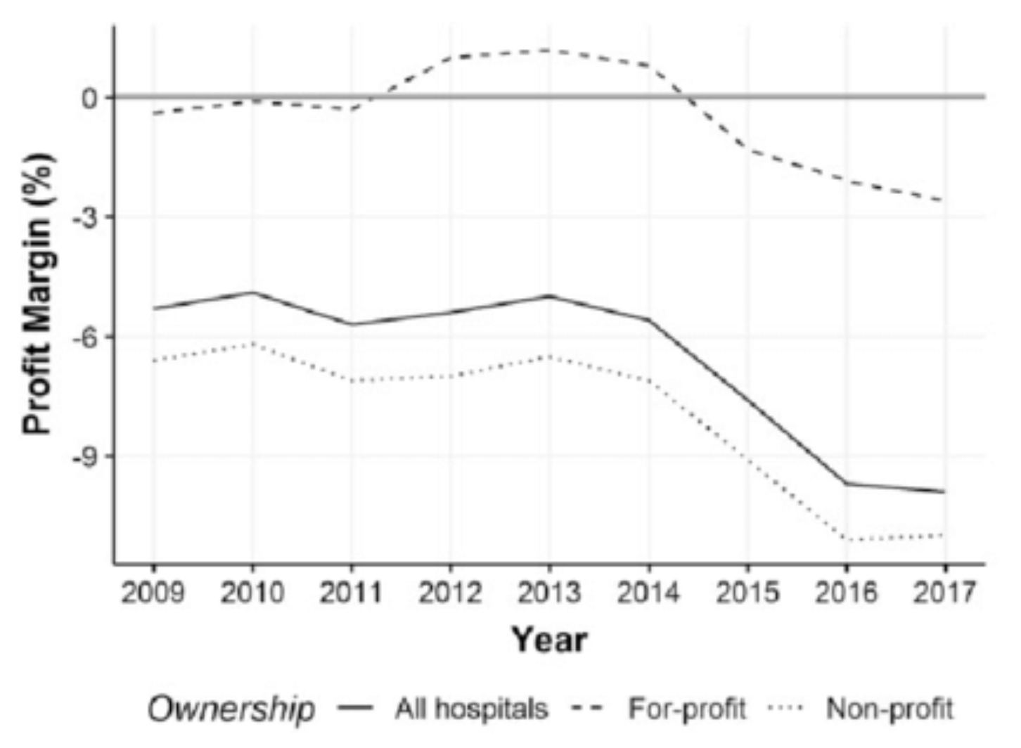
Trends in U.S.
Hospital
Profits

